Slide 1

TurboTrucks
Team CodeNinjas
By:
Jonathan Della Penta – 40128210
Julie Makary – 40243160
George Ezzat – 40245502

Slide 2
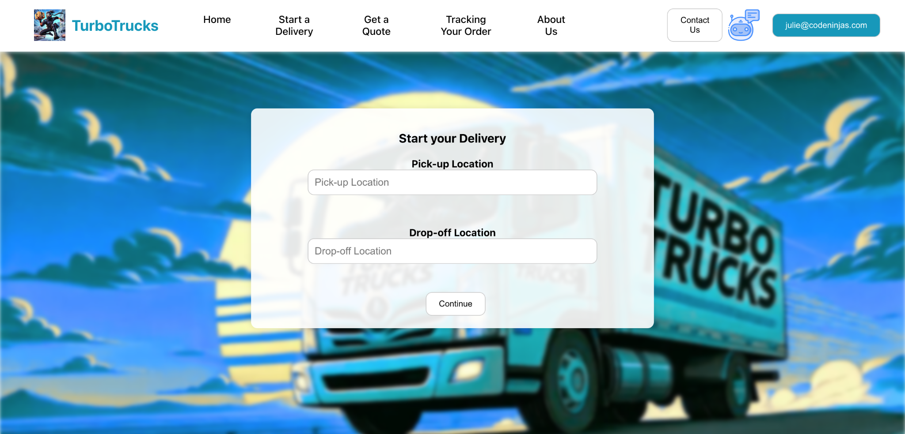
Project Overview
Delivery system that values user experience (Not only clients, but for administrators as well)
Provides users with many features
Easy to use interface

Slide 3
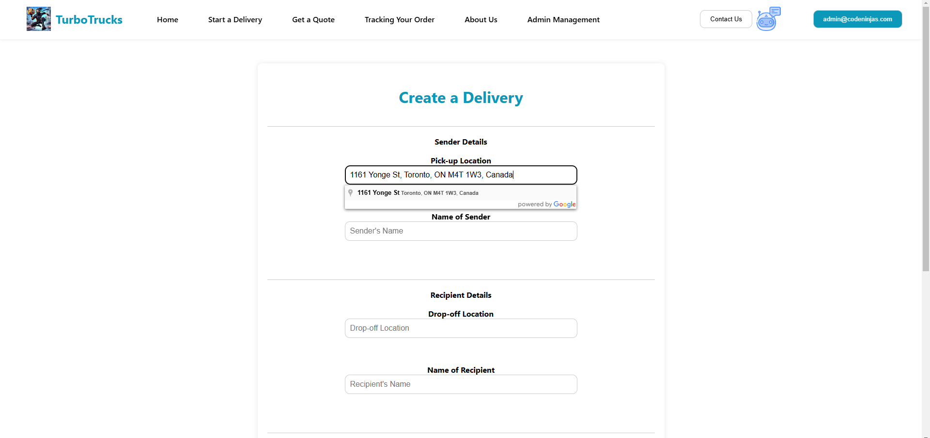
System Architecture
User authentication (Sign up/ Log in)
Delivery request service: Manages pickup and drop-off requests from users

Slide 4
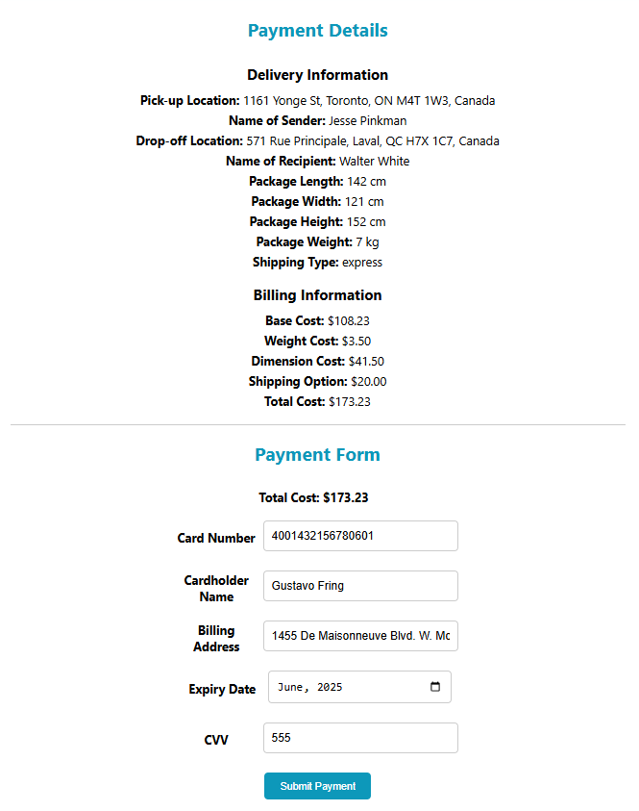
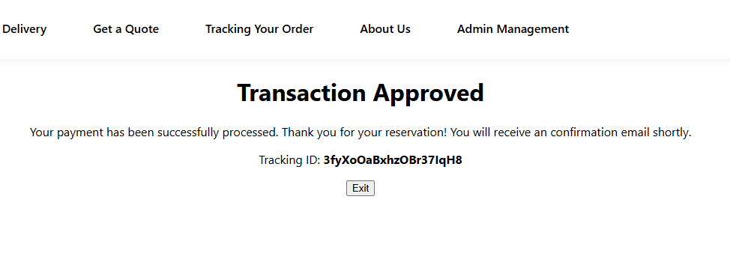
System Architecture (cont.)
3. Payment service: Handles secure
transactions for completed delivery
orders

Slide 5
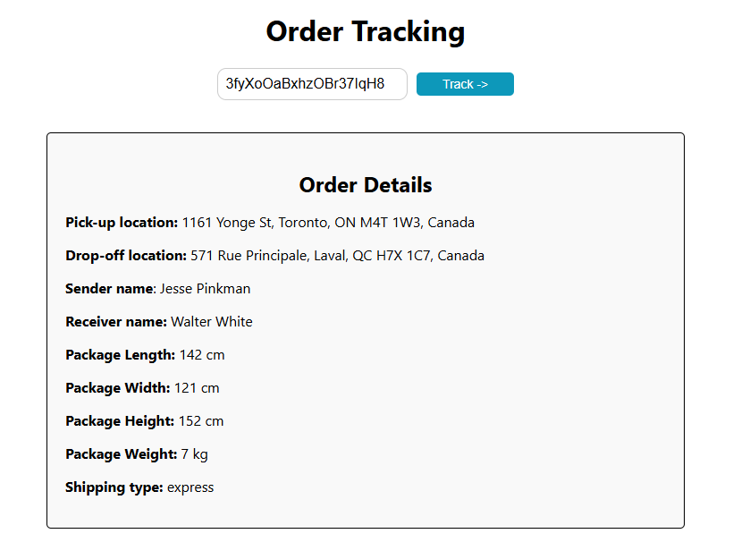
System Architecture (cont.)
4. Tracking service: Enables real-time tracking of packages

Slide 6
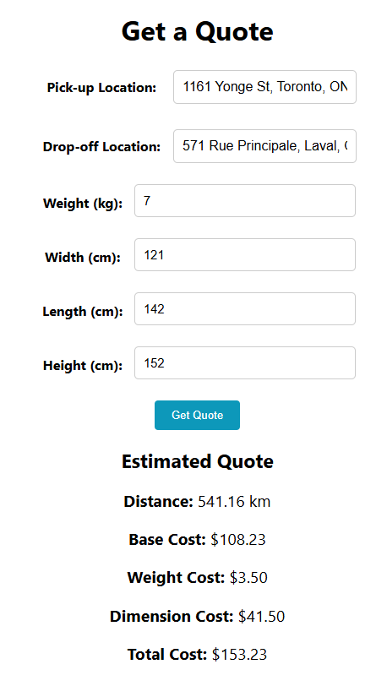
System Architecture (cont.)
5. Quotation service: Provides delivery
quotes based on package
details and routes

Slide 7
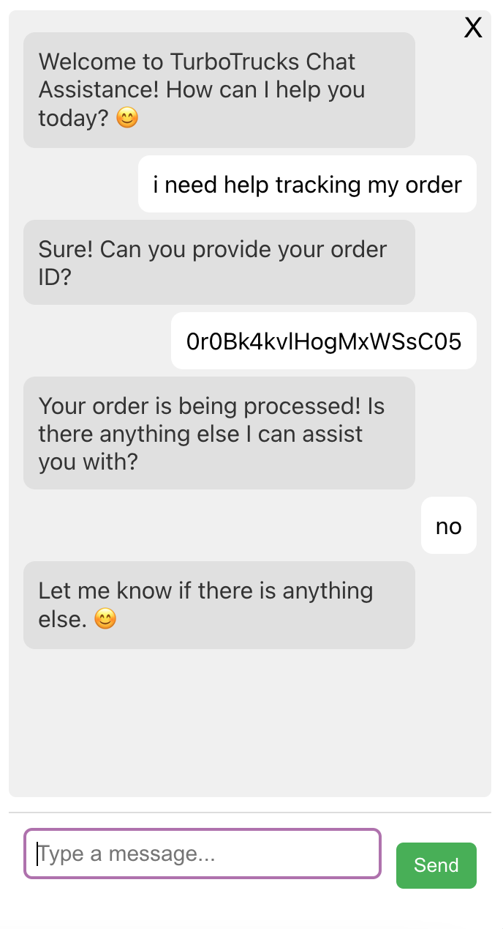
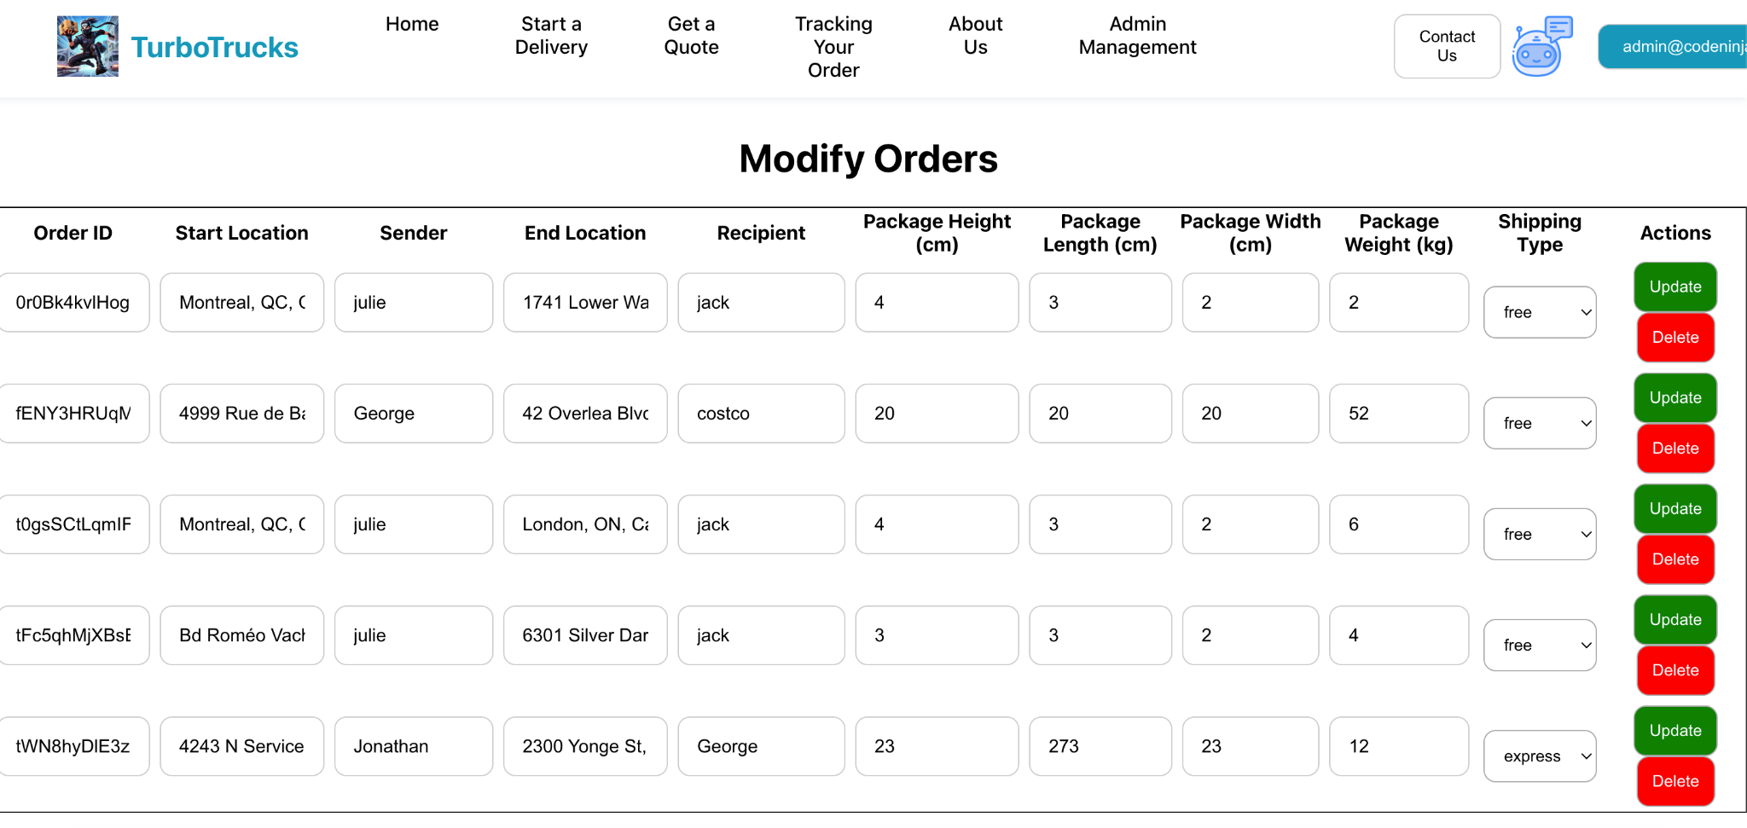
System Architecture (cont.)
6. Chatbot: Provides users with 24/7 assistance using AI technology
7. Administration services: Provides tools for administrators to oversee operations

Slide 8
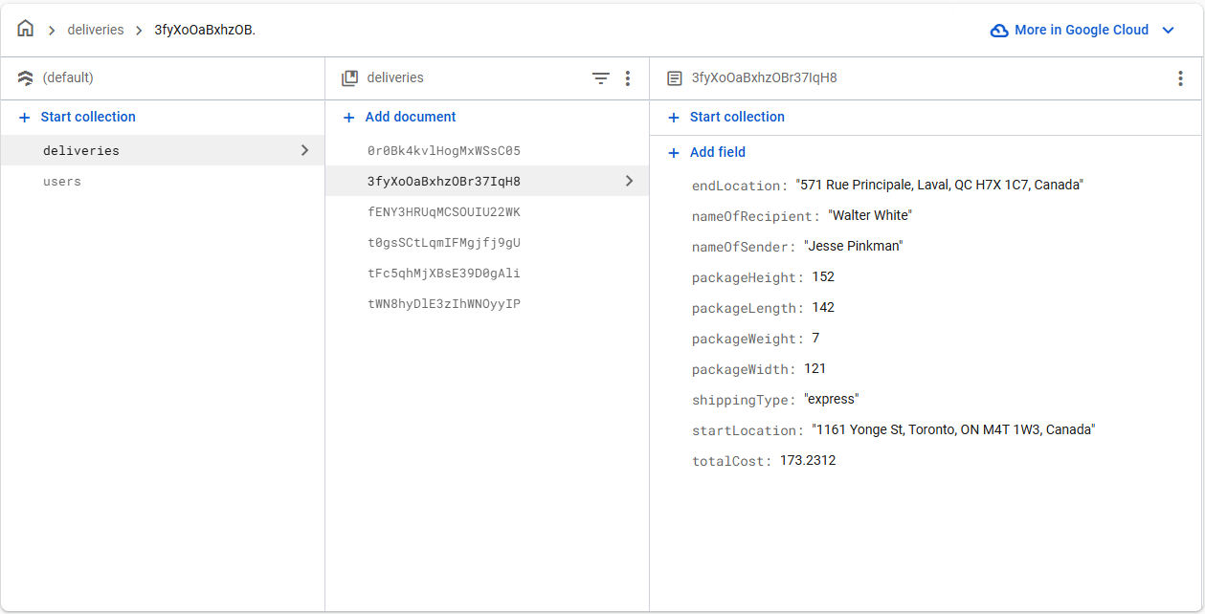
System Architecture (cont.)
Firestore DB

Slide 9
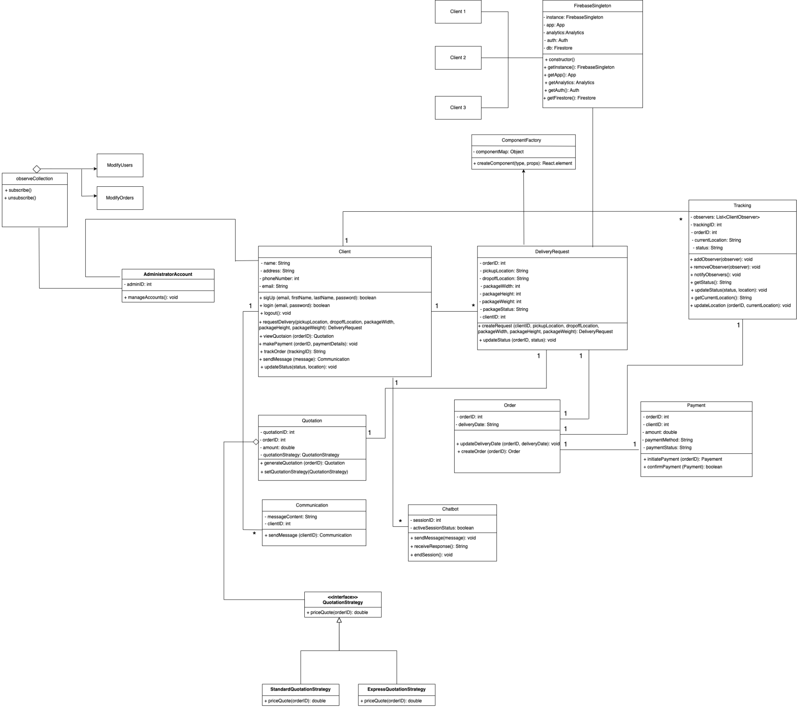
Class Diagram

Slide 10
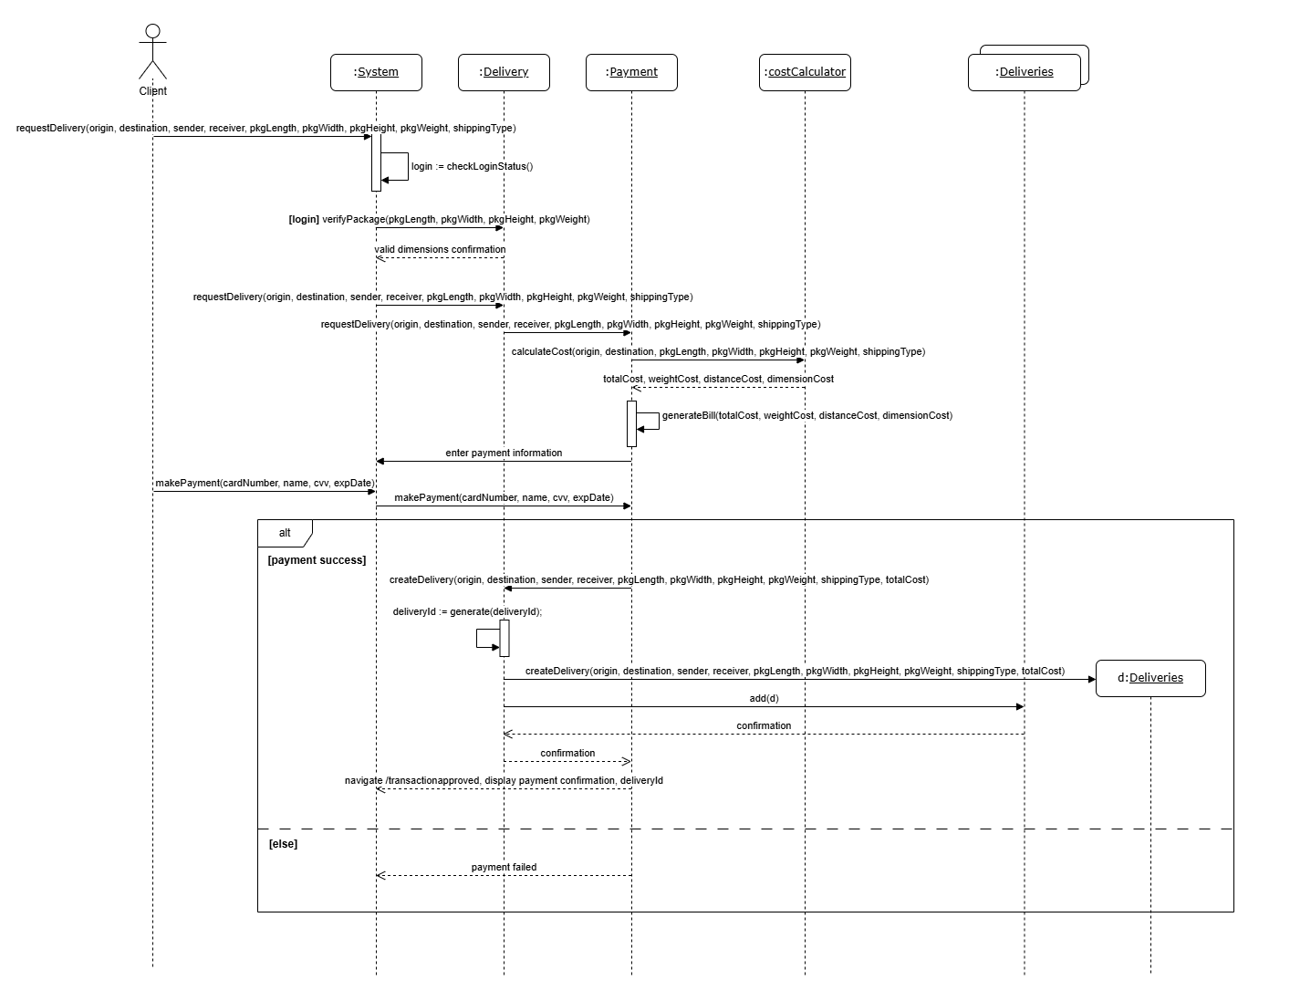
Sequence Diagrams
Creating a Delivery
Payment

Slide 11
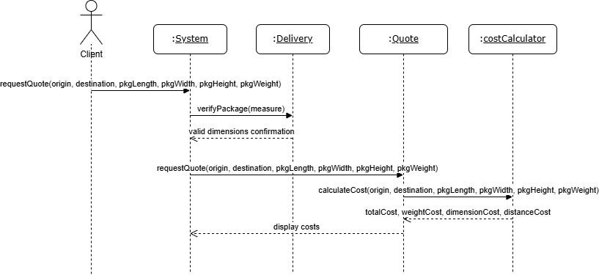
Sequence Diagrams
Quote

Slide 12
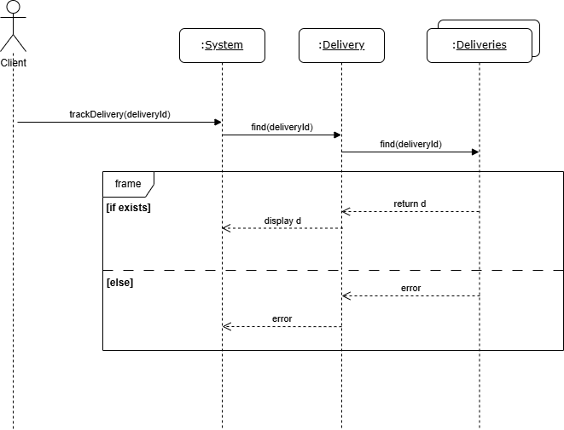
Sequence Diagrams
Tracking

Slide 13
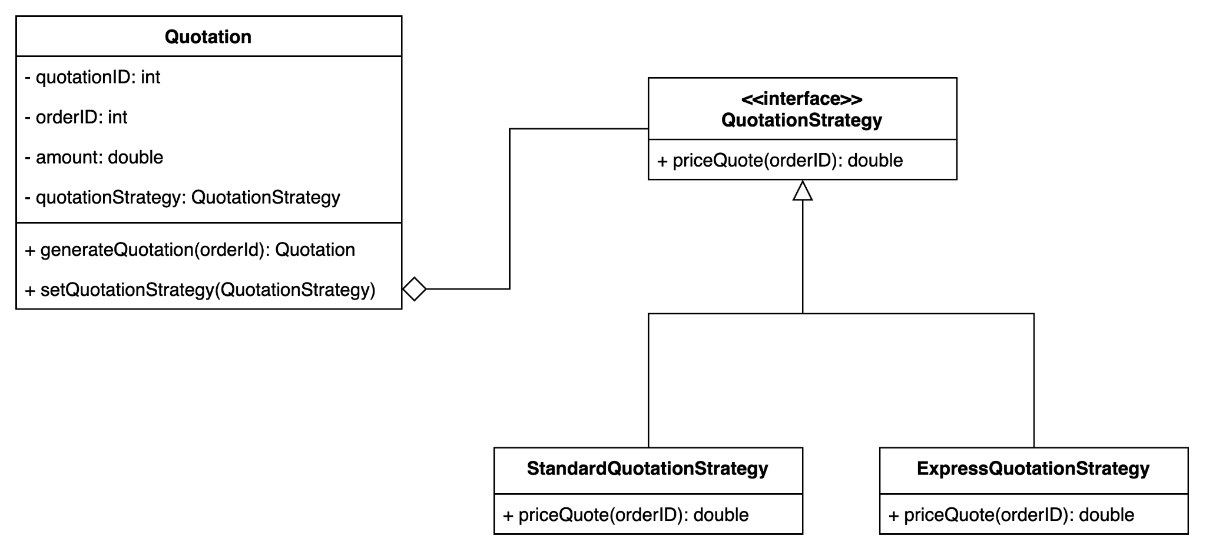
Design patterns: Strategy
The strategy pattern is used when generating a price
We offer different strategies of delivery: Standard free shipping (3-5 business days) or Express shipping (1-2 business days)
This pattern encapsulates and varies the delivery process without modifying the core system logic

Slide 14
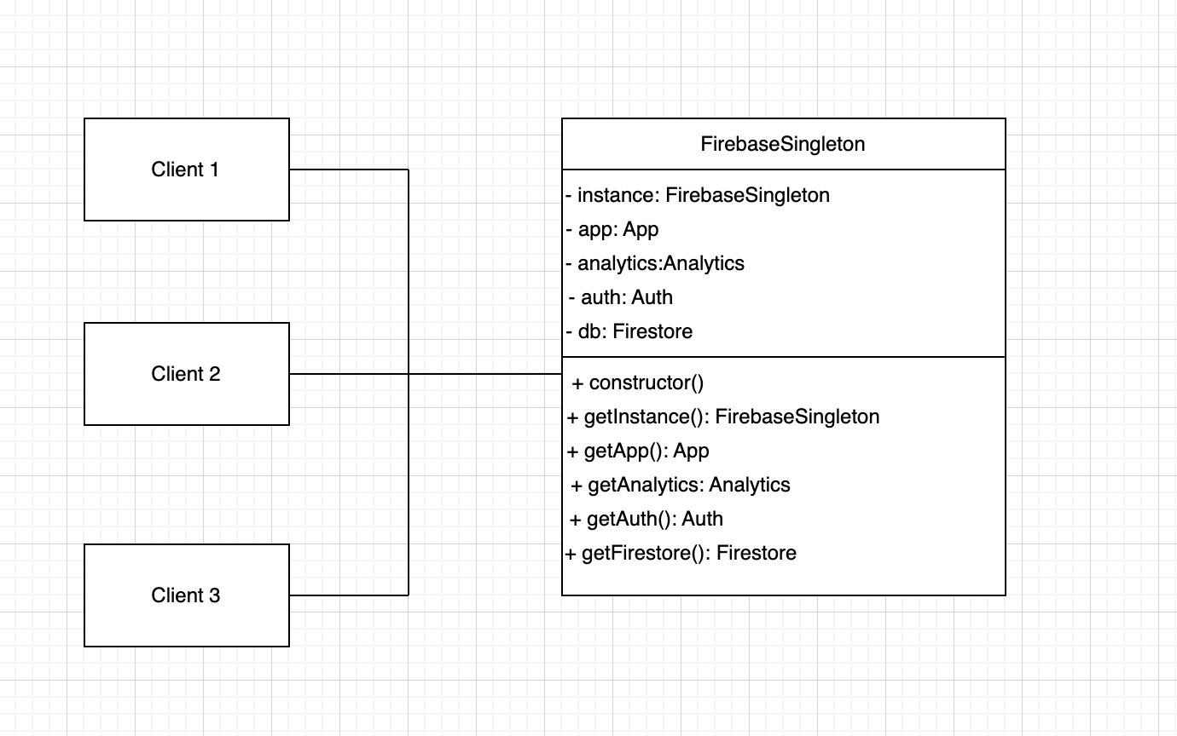
Design patterns: Singleton
The singleton pattern is used to manage instances of our backend, Firebase
The class FirebaseSingleton serves as a single point of interaction for the database
Implemented as a singleton to ensure there’s only one active instance handling all communications
Encourages simpler, organized code

Slide 15
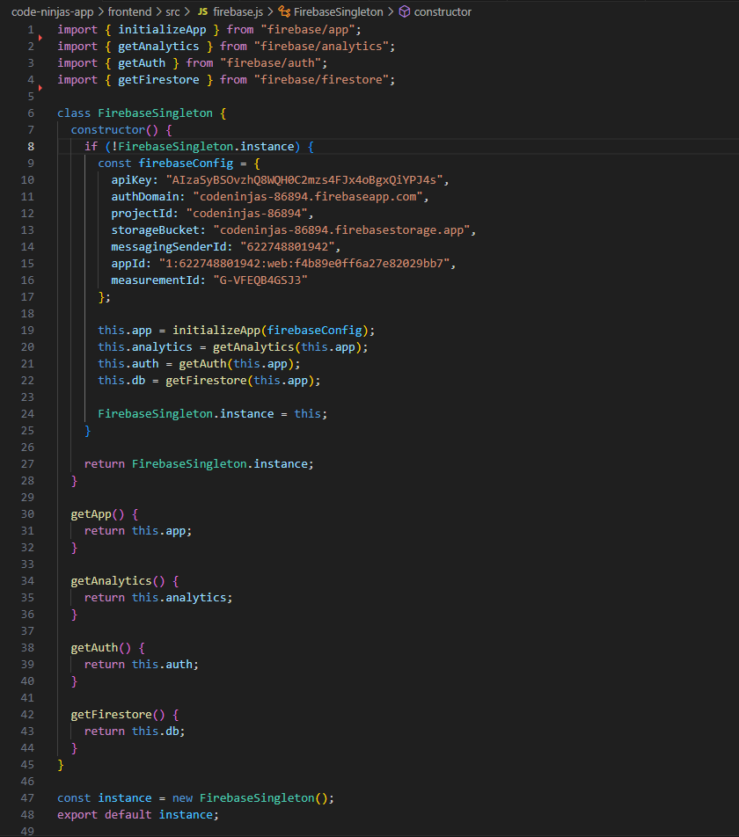
Design Patterns: Singleton
Imports all used functions
The class initializes the functions and returns an instance
Methods are created for interactions
Class can be imported to any components that wish to interact with DB or authentication
Avoids copy/pasted code in multiple components. If an error occurs, only has to be resolved in one file.

Slide 16
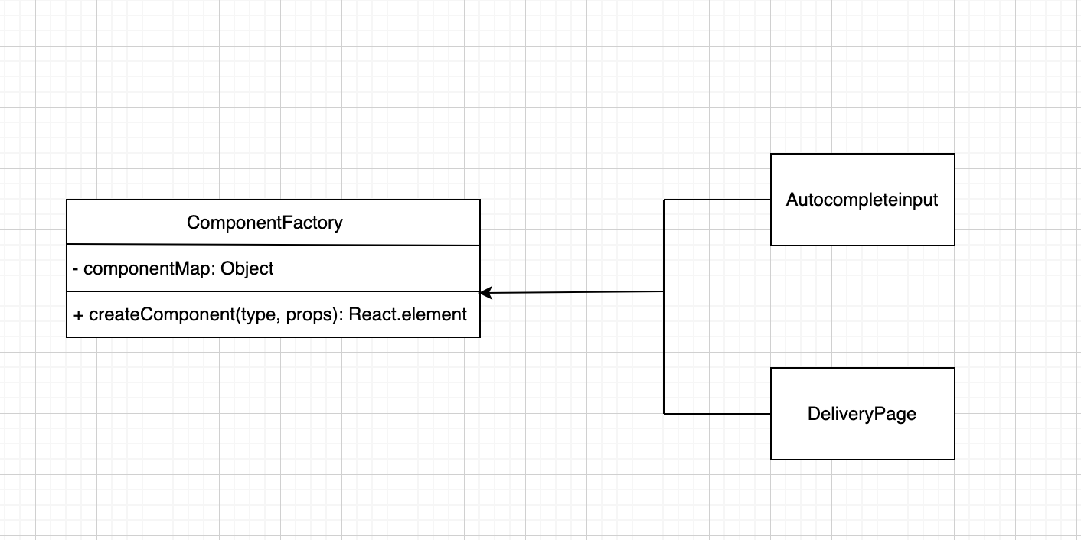
Design patterns: Factory
The Factory pattern is used to create input fields that implement the Google Maps Autocomplete API.
Many components that use this feature (Home page, Delivery form, Quote)
More Scalable.

Slide 17
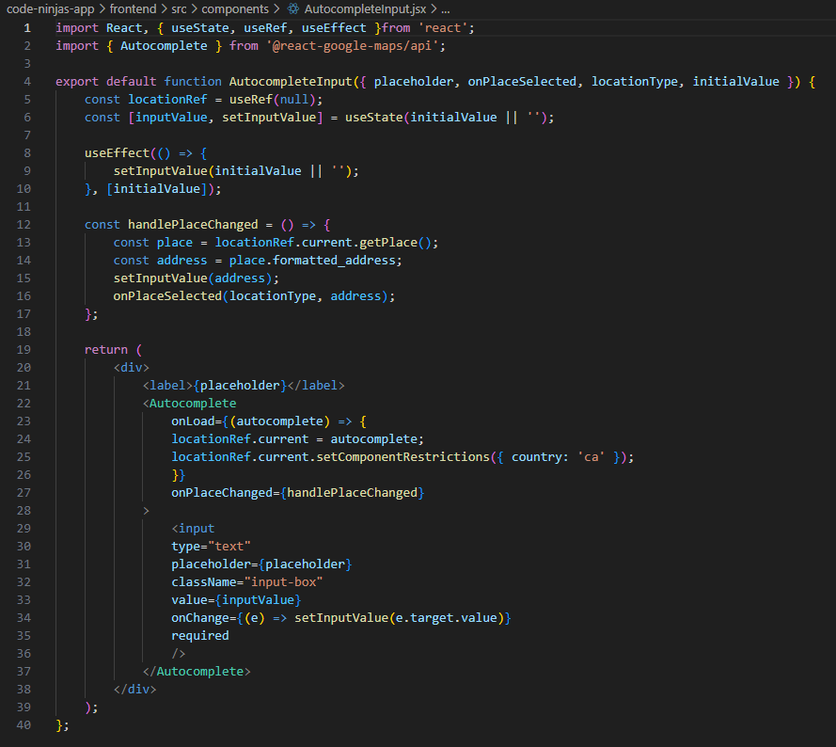
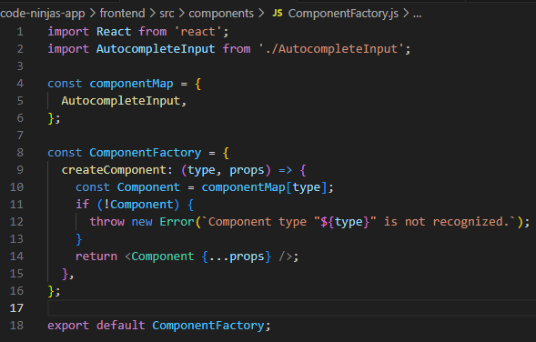

Slide 18
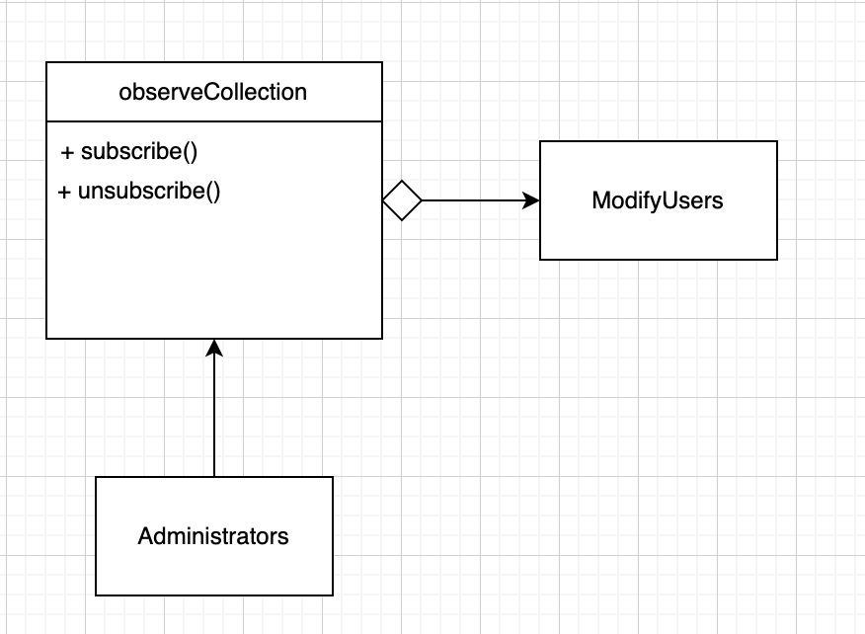
Design patterns: Observer
The observer pattern is used in the admin pages: modifyUsers and modifyOrders
The database is constantly changing when orders are being made, or removed
These components subscribe to receive updates on the database through a listener.

Slide 19
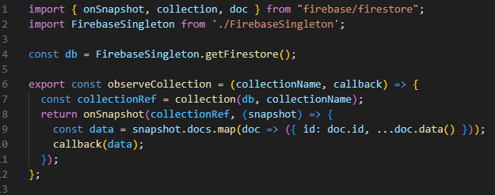
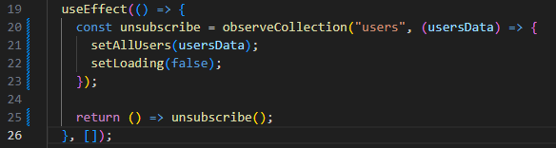

Slide 20
Details of the GUI
Implemented using React
Designed to provide users with a seamless experience to interact with the delivery service
Home screen consists of logging in/signing up, request a delivery, get a quote, track a delivery, about us page and the chatbot

Slide 21
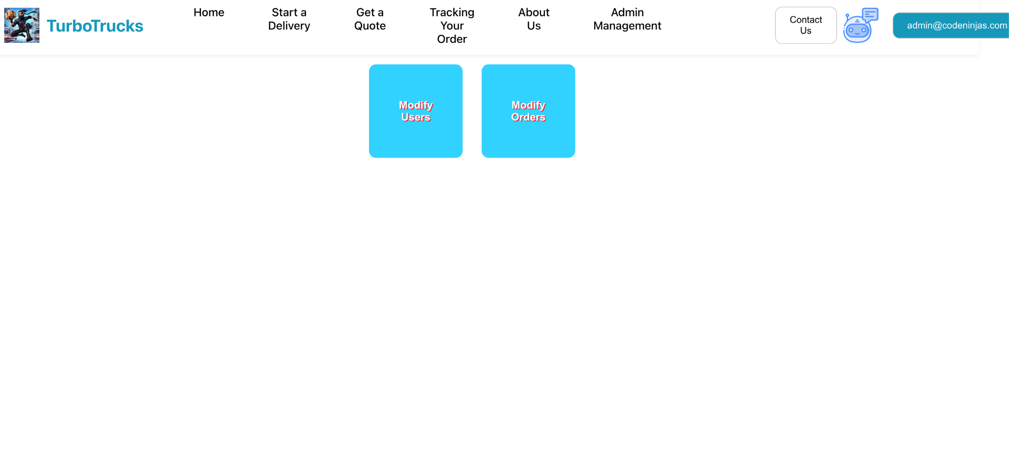
Details of the GUI (cont.)
Each page has its own representation based on the service it provides
Each have their own input fields (locations implemented with google maps API)
Administrators have the same GUI but with one extra functionality: Admin management where administrators can modify users and orders

Slide 22
Comparisons to Existing Solutions
Real time tracking and status update
Integration of multiple users (clients and administrators)
Customizable delivery methods (standard free shipping vs express shipping)
Simple quote generation
24/7 chatbot for customer support
Reporting and analytics for administrators

Slide 23
Conclusion
Designing the complete system before implementing it to
ensure smooth development and user satisfaction
Implementing design patterns to enhance development
User experience

